Slide 1

Digital Logic Design Project
CS - 216 / EE - 214

Slide 2
Keyboard And LED Grid System
GROUP - 1
Himanshu (160020030)
Ankit Gupta (160020009)
Ravi Meena (160020008)
Shivam Pandey (160010003)

Slide 3
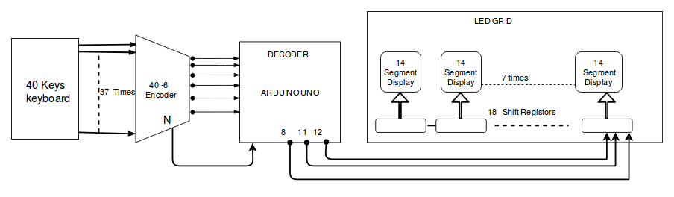
Block Diagram

Slide 4
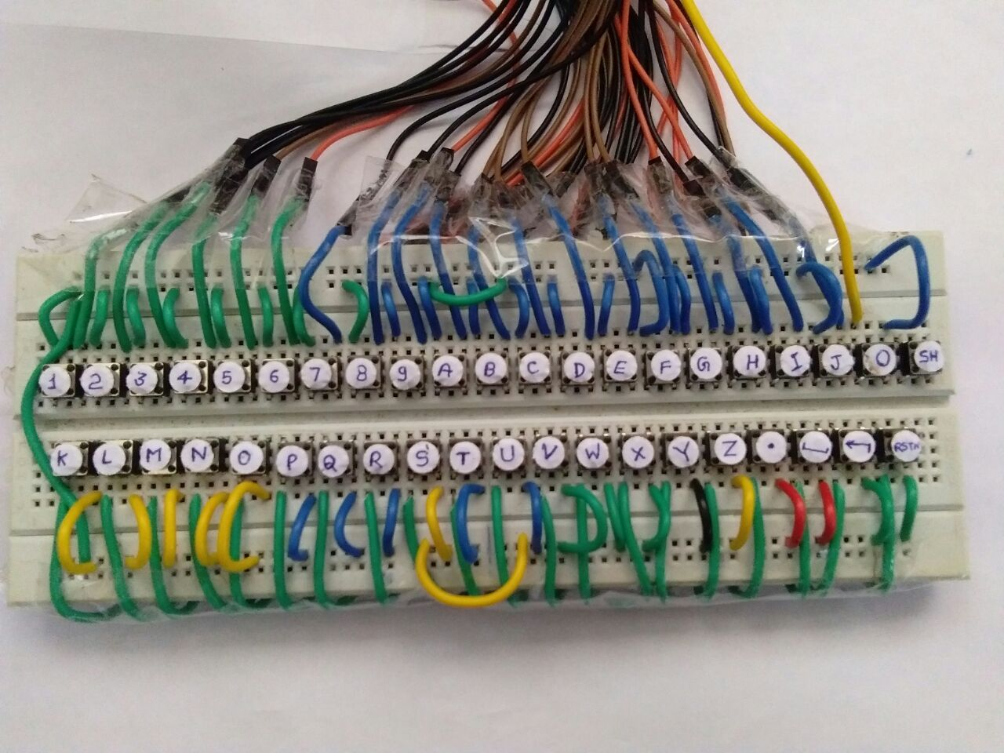
Keyboard
It has 40 keys,0-9,A-Z ,decimal point,space,backspace and reset,
Gives 40 Bit One hot output.
Momentary Push-button switches are used.

Slide 5
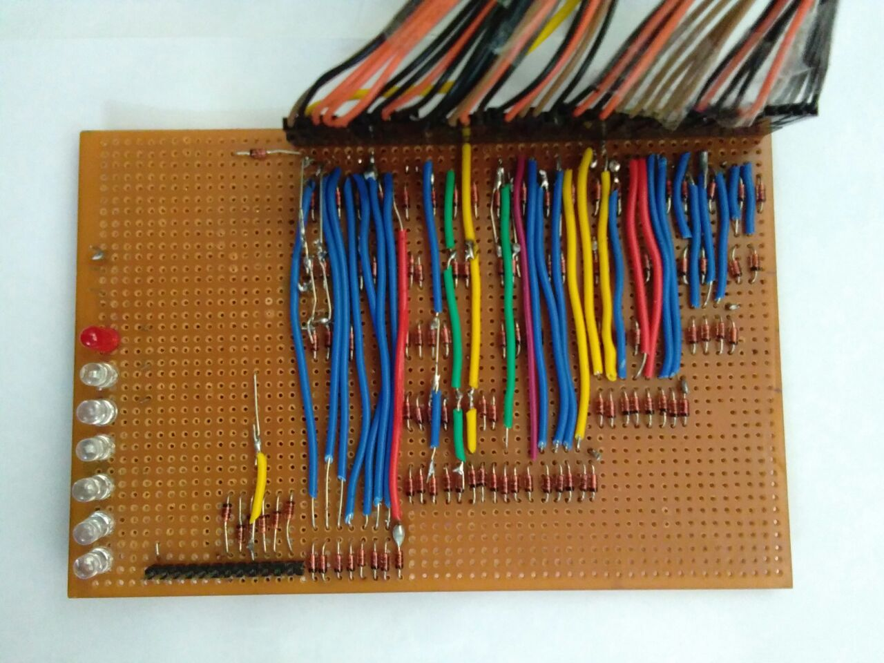
Encoder
It Encodes 40 Bit input received from keyboard into 6 bits representing the number of the key pressed.
Diode Logics are used to implement the boolean functions.
108 x IN4148 Diodes are used.
There are 7 outputs from encoder ,6 bit number and one indicator bit.

Slide 6
Decoder
It Decodes 6 bits output received from encoder into 14 bits.
These 14 bits are used to light the LEDs of 14 segment LED display.
We formed 14 boolean functions of 6 variables.
Implementing these 14 functions in hardware were requiring 97 AND gates and 67 OR gates and one gate was costing 10 rupees thus it was not cost efficient.
We then decided to implement these functions using PLA ICs but they were not commercially available and are outdated.
So Implemented these functions using ARDUINO UNO which is easy to program.

Slide 7
LED Grid
To display one character, we have used 14 segment display.
To give a better look and more clarity, we’ve used 30 LEDs for 14 segment display.
Grid is able to display 10 characters , so in total 300 LEDs are used.
To store 140 bits , we’ve used shift registers.(The model of the shift register used is 74HC595N).
A single shift register is able to store 8 bits. So, we’ve used 18 shift registers.
Input to the shift register is controlled by a microcontroller, in our case which is the Arduino UNO.

Slide 8
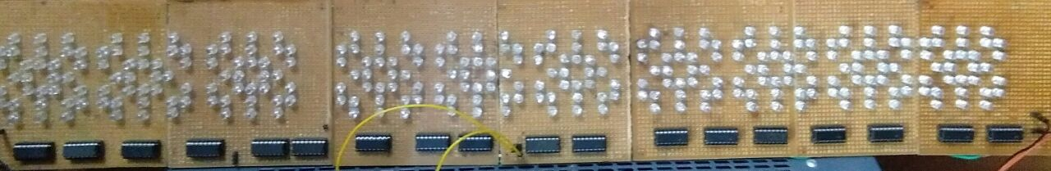
LED Grid Image

Slide 9
Thankyou

